Slide 1
Using Social Media in Research: Privacy, Trust, & Ethics
Dan O’Connor, PhD
Head of Humanities & Social Science
@drdanoconnor

Slide 2
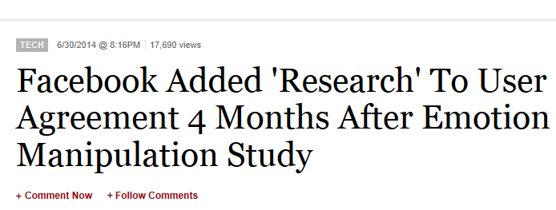
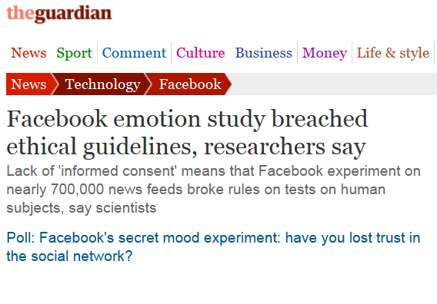
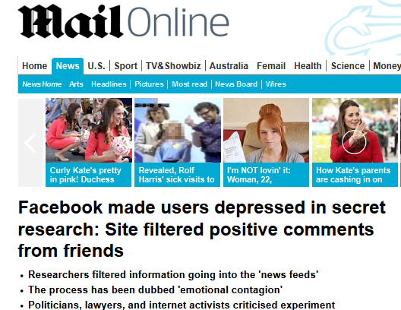
Facebook “Scandal”

Slide 3
Outline
Types of social media research
Some examples
Ethical challenges (old and new)
Overcoming the challenges

Slide 4
Types of Social Media Research
Research using social platforms
or
Research ‘into’ social content

Slide 5
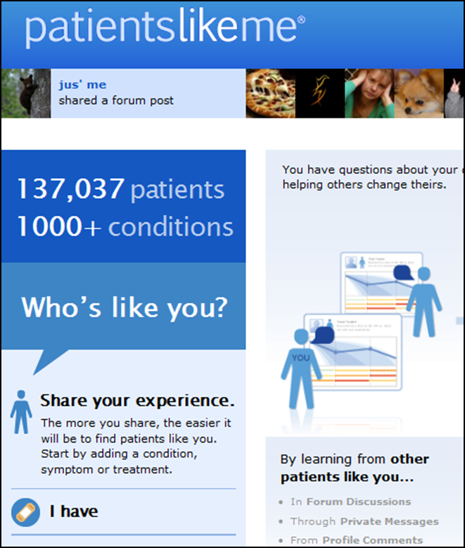
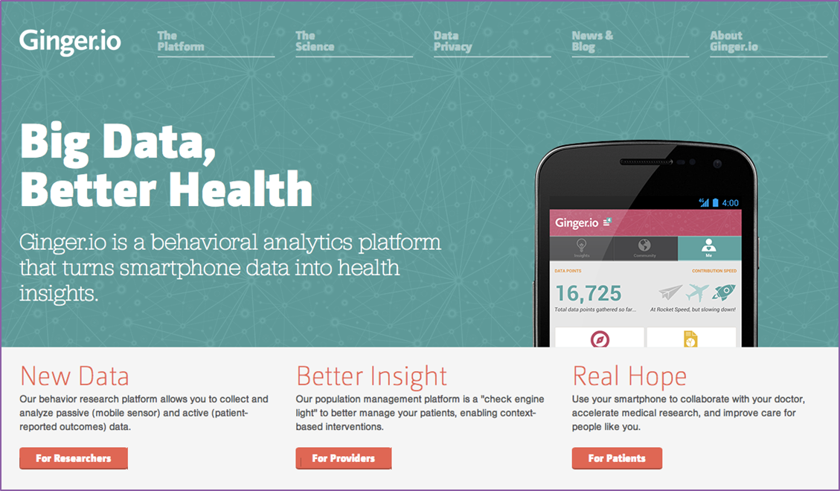
Research Using Social Platforms

Slide 6
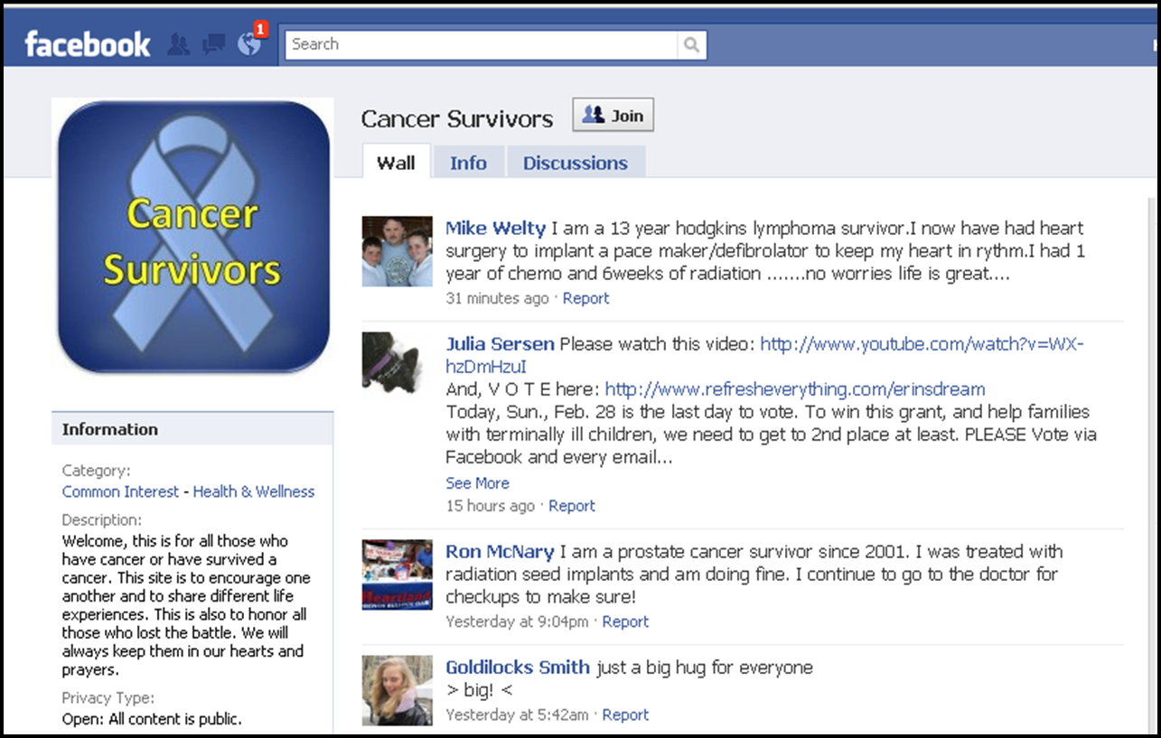
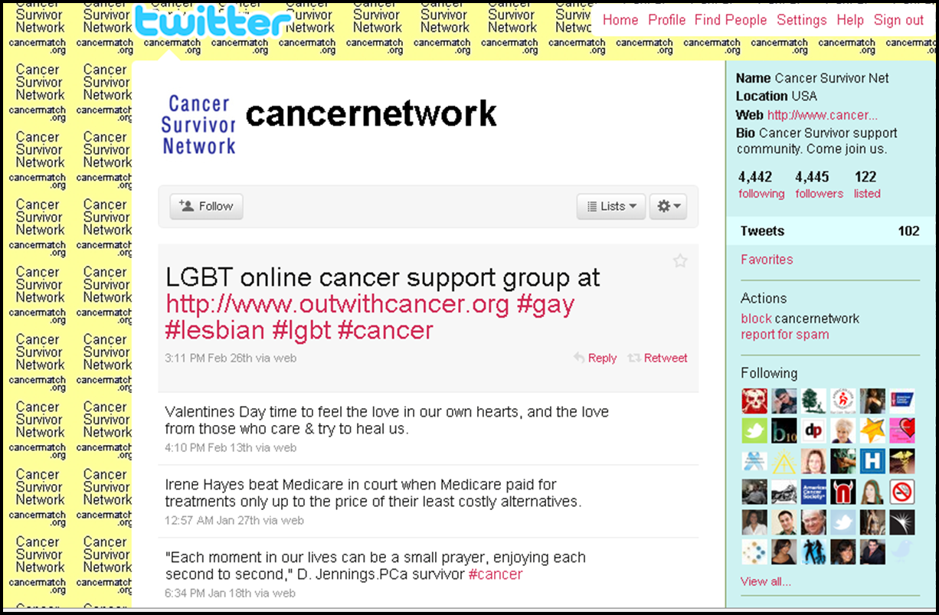
Research into Social Content

Slide 7
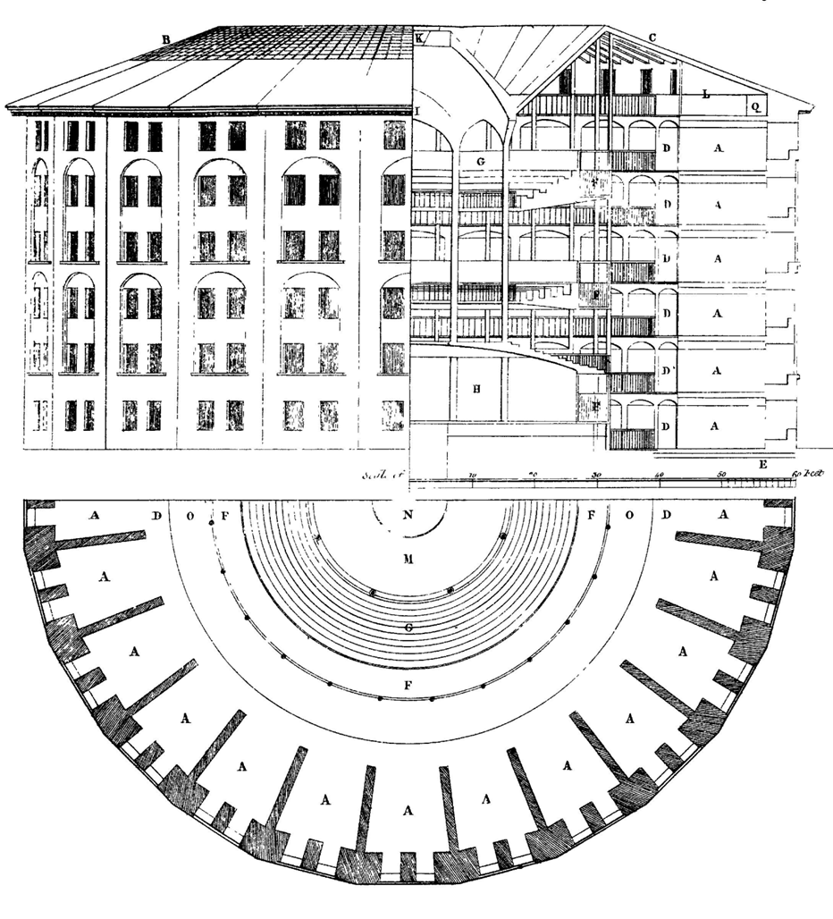
Surveillance / Monitoring / Listening

Slide 8
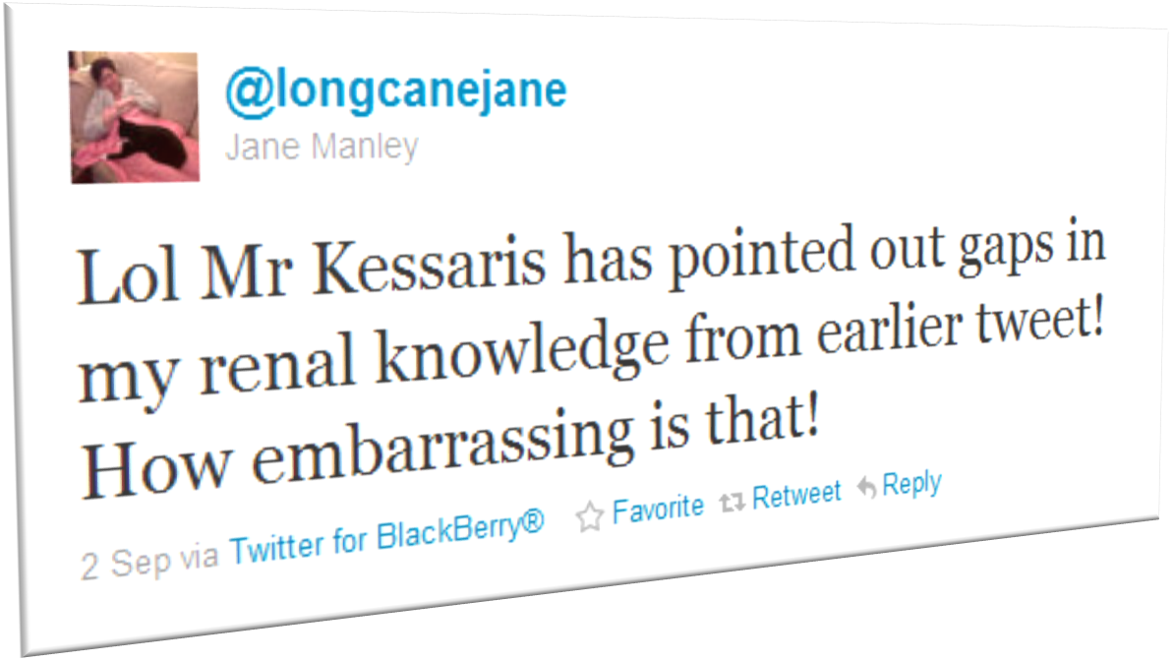
“The Case of the Tweeting Kidney Patient”

Slide 9
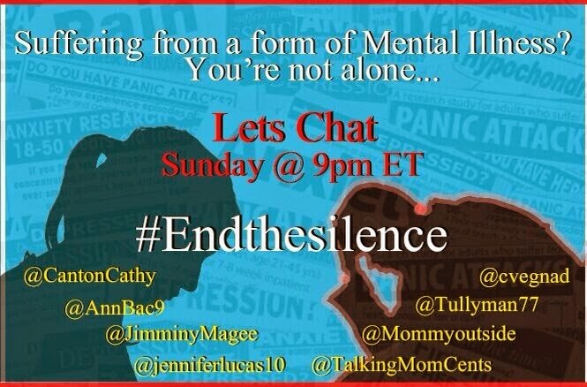
Mental Health and Twitter

Slide 10
The Slash Fiction Farago of ‘09
“And so we decline to be interviewed by you; we decline to be the objects of your fascination; we decline to be naturalized; we decline to allow our political project to be cited in support of the very discourses we are trying to question”
http://eruthros.dreamwidth.org/273840.html

Slide 11

Big Issue: PRIVACY

Slide 12
Regulation Academic Bit
Daniel Solove:
“A Taxonomy of Privacy”, 154 U. Pa. Law Review. 477 (2006)
Understanding Privacy (Harvard UP, 2004)

Slide 13
Solove’s Taxonomy
Information Collection
Information Processing
Information Dissemination
Invasion

Slide 14
A new new taxa: “Self-Exposure”
Patricia Sanchez-Abril & Anita Cava, “Health Privacy in a Techno-Social World: A Cyber-Patient's Bill of Rights”, 6 Nw. J. Tech. & Intell. Prop. 244 (2008).

Slide 15
Expectations of Privacy

Slide 16
Expectations of Privacy
Do social media users have a responsibility to protect their own privacy?
What responsibilities do researchers have to respect social media users’ privacy?

Slide 17
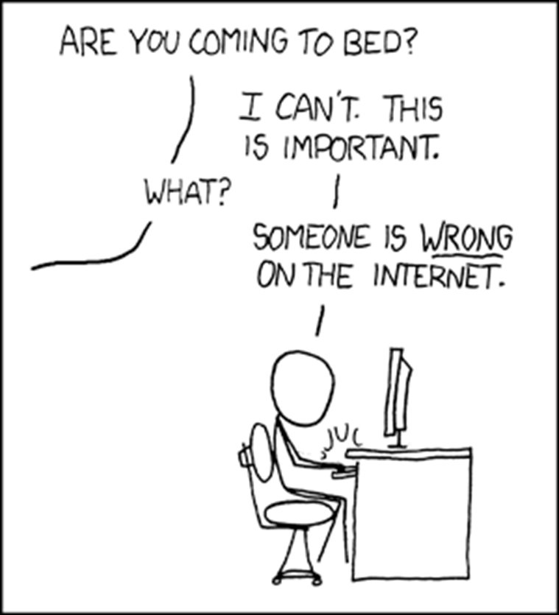
http://xkcd.com/386/

Slide 18
Approaches / Solutions
Transparency (be open! be honest!)
Community involvement (be social!)
Wheaton’s Law (“don’t be a d**k”)

Slide 19
d.oconnor@wellcome.ac.uk
@drdanoconnor

